Slide 1
Least-squares best-fitting polynomials

Slide 2
Introduction
In this topic, we will
Describe approximating Au = v when no exact solution exists
Introduce the normal equation
Use the normal equation to find the
Best-fitting linear polynomial that fits noisy data
Best-fitting quadratic polynomial that fits noisy data

Slide 3
Review
From linear algebra:
Suppose that A:R² → R⁴ and Au = v has no solution
If the columns of A are linearly independent, this requires that the system is overdetermined with rank 2
That is, there are more equations than unknowns and the system is inconsistent

Slide 4
Review
From linear algebra:
A simple example:
The first two rows indicate that u₁ = u₂ = 1
In this case, however, 2u₁ + 3u₂ = 5, and not 8
Thus, this system of three linear equations in two unknowns is inconsistent
No solution exists

Slide 5
Review
Thus, it is almost certain that no linear combination of the columns of A that equals the target vector
Thus, for all u₁ and u₂,
What’s the next-best choice?
How about, what linear combination is closest to v?

Slide 6
Review
Let A:U →V be a linear map
Usually, A: R^{n} → R^{m}
Thus, we want to minimize
That is, find a u that makes this as small as possible
Now, consider a plane (e.g., a floor) and a point not on that plane
The location on the plane closest to the point is one that forms a perpendicular line
We need to find a vector u₀ such that Au₀ – v is perpendicular to all vectors in the range of Au
Two vectors are perpendicular if their dot product is zero

Slide 7
Review
Thus, we require that
for all u in the domain R^{n}
If this is true, then must be true for all u in R^{n}
This is true if and only if

Slide 8
Review
Therefore, the solution u₀ to which may sometimes be calculated as is that vector u₀ that minimizes

Slide 9
Review
Let’s try this out:
>> A = [3.1 4.0; 2.8 7.6; 5.9 1.2; 6.4 8.7];
>> v = [5.6 0.8 7.3 9.1]';
>> u = (A'*A) \ A'*v
u =
1.472633619403234
-0.169731501459659
>> A*u
ans =
3.886238214311391
2.833414723235649
8.484860552727493
7.948191101481669
>> norm( A*u - v )
ans =
3.130864603088711

Slide 10
Least-squares best-fitting linear polynomial
Suppose we have some data points
If there were only two points, we could solve
Now, however, we have five:
y₃
y₅
y₂
y₄
y₁
x₁
x₂
x₃
x₄
x₅

Slide 11
Least-squares best-fitting linear polynomial
We proceed by asking:
What linear combination comes closest to our target vector
y₃
y₅
y₂
y₄
y₁
x₁
x₂
x₃
x₄
x₅

Slide 12
Least-squares best-fitting linear polynomial
We have already seen the solution:
Solve
y₃
y₅
y₂
y₄
y₁
x₁
x₂
x₃
x₄
x₅

Slide 13
Least-squares best-fitting linear polynomial
We have already seen the solution:
Solve
y₃
y₅
y₂
y₄
y₁
x₁
x₂
x₃
x₄
x₅

Slide 14
Least-squares best-fitting linear polynomial
The solution gives us the best-fitting line
The sum of the squares of the errors is minimized
y₃
y₅
y₂
y₄
a₁x + a₀
y₁
Do not memorize the 2 × 2 matrix or the target vector
- Understand they are the result of calculating A^{T}A and A^{T}y
x₁
x₂
x₃
x₄
x₅

Slide 15
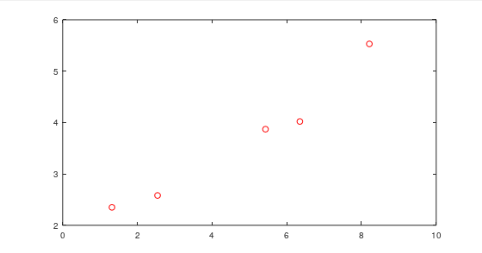
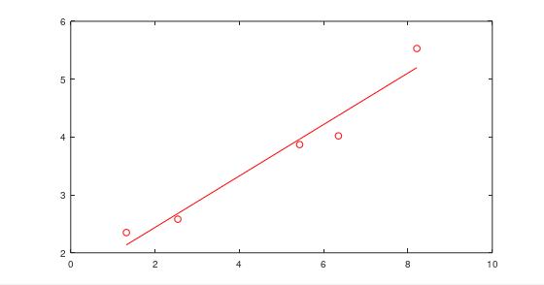
Example
Let’s try this in Matlab
>> x = [1.32 2.54 5.43 6.35 8.21]';
>> y = [2.35 2.58 3.87 4.02 5.53]';
>> plot( x, y, 'ro' )
>> A = vander( x, 2 )
A =
1.3200 1.0000
2.5400 1.0000
5.4300 1.0000
6.3500 1.0000
8.2100 1.0000
>> format long
>> a = (A'*A) \ (A'*y)
a =
0.444616162573875
1.549180904522615
>> hold on
>> plot( x, polyval( a, x ), 'r' );
This Matlab code is provided for demonstration purposes and is not
required for the examination.

Slide 16
Least-squares best-fitting quadratic polynomial
Suppose we have some data points
If there were three points, we could solve
Now, however, we have five:
y₃
y₅
y₂
y₄
y₁
x₁
x₂
x₃
x₄
x₅

Slide 17
Least-squares best-fitting quadratic polynomial
We proceed by asking:
What linear combination comes closest to
y₃
y₅
y₂
y₄
y₁
x₁
x₂
x₃
x₄
x₅

Slide 18
Least-squares best-fitting quadratic polynomial
As before, we can solve this:
Solve
y₃
y₅
y₂
y₄
y₁
x₁
x₂
x₃
x₄
x₅

Slide 19
Least-squares best-fitting quadratic polynomial
As before, we can solve this:
Solve
y₃
y₅
y₂
y₄
y₁
Do not memorize the 3 × 3 matrix or the target vector
- Understand they are the result of calculating A^{T}A and A^{T}y
x₁
x₂
x₃
x₄
x₅

Slide 20
Least-squares best-fitting quadratic polynomial
The solution gives us a quadratic curve that most closely approximates these points
The sum of the squares of the errors is minimized
y₃
y₅
y₂
y₄
a₂x² + a₁x + a₀
y₁
x₁
x₂
x₃
x₄
x₅

Slide 21
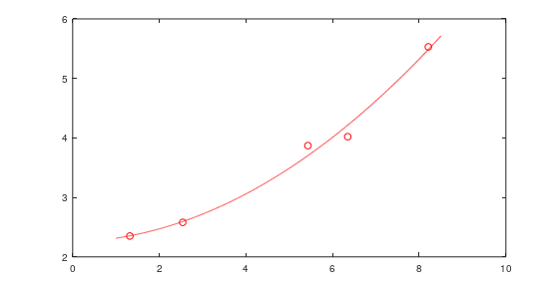
Example
Let’s try this in Matlab
>> x = [1.32 2.54 5.43 6.35 8.21]';
>> y = [2.35 2.58 3.87 4.02 5.53]';
>> plot( x, y, 'ro' )
>> A = vander( x, 3 )
A =
1.7424 1.32 1
6.4516 2.54 1
29.4849 5.43 1
40.3225 6.35 1
67.4041 8.21 1
>> format long
>> a = (A'*A) \ (A'*y)
a =
0.04547642859987164
0.02113915928445630
2.246661642457417
>> hold on
>> xs = 1:0.01:8.5;
>> plot( xs, polyval( a, xs ), 'r' );
This Matlab code is provided for demonstration purposes and is not
required for the examination.

Slide 22
Example
Incidentally, in Matlab if you try to solve an overdetermined system of linear equations, it automatically gives you the least-squares best-fitting solution:
>> a = (A'*A) \ (A'*y)
a =
0.04547642859987164
0.02113915928445630
2.246661642457417
>> a = A \ y
a =
0.04547642859987018
0.02113915928447047
2.246661642457392

Slide 23
Least-squares best-fitting constant polynomial
What is the best constant polynomial y = a₀ passing through data?
y₃
y₅
y₂
y₄
y₁
x₁
x₂
x₃
x₄
x₅

Slide 24
Least-squares best-fitting constant polynomial
What is the best constant polynomial y = a₀ passing through data?
The solution is
y₃
y₅
y₂
y₄
y₁
x₁
x₂
x₃
x₄
x₅

Slide 25
Summary
Following this topic, you now
Understand the idea of finding the solution such that Au is closest to a target vector v
Know that this requires you to solve A^{T}Au = A^{T}v
Understand that this can be used to find least-squares best-fitting polynomials passing through data
We can find a least-squares constant polynomial, least-squares linear polynomial, least-squares quadratic polynomial and others

Slide 26
References
[1] https://en.wikipedia.org/wiki/Least_squares

Slide 27
Acknowledgments
None so far.

Slide 28
Colophon
These slides were prepared using the Cambria typeface. Mathematical equations use Times New Roman, and source code is presented using Consolas. Mathematical equations are prepared in MathType by Design Science, Inc.
Examples may be formulated and checked using Maple by Maplesoft, Inc.
The photographs of flowers and a monarch butter appearing on the title slide and accenting the top of each other slide were taken at the Royal Botanical Gardens in October of 2017 by Douglas Wilhelm Harder. Please see
https://www.rbg.ca/
for more information.

Slide 29
Disclaimer
These slides are provided for the ece 204 Numerical methods course taught at the University of Waterloo. The material in it reflects the author’s best judgment in light of the information available to them at the time of preparation. Any reliance on these course slides by any party for any other purpose are the responsibility of such parties. The authors accept no responsibility for damages, if any, suffered by any party as a result of decisions made or actions based on these course slides for any other purpose than that for which it was intended.

